Slide 1

Let’s talk about someone special-you!
With Mritunjay Sharma

Slide 2
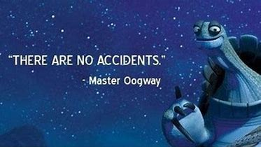

Slide 3
Say a Good Sunday Morning with this beautiful quote!
History
Yesterday was a
Gift
And that is why it is called the present.
Mystery
Tomorrow is a
But Today is a

Slide 4
Why am I invited here?
Earlier life
Landing at JSS, Noida
Trying to find myself

Slide 5
I + E = U
Don’t solve this equation, can you decipher it for me?

Slide 6
Decrypting I + E = U
I (Body)
E (Shakti, Energy)
U(Universe)

Slide 7
You are not alone!
Doubt whether you can do it?
Not able to find your passion?
Problems in Problems Solving?
Imposter Syndrome?

Slide 8
Who is with you – We – The Community.
Who is the first one? Your college clubs!
Find Regional Communities
Engage with Global Communities
Then what? Go and empower others!

Slide 9
It’s not a lie when they say: Your Network is your Net worth.
Community member now? Start networking!
Build connections.
Convert connections to relations.

Slide 10
Let’s now take a look of communities I am part of!
What is MSFT Learning Ambassdors Program all about and how you can apply?
It is about leadership.
Your contributions and eagerness to help fellow students.
Organizing Hackathons, Talks, Workshops, etc.
Growing your skills

Slide 11
Let’s now take a look of communities I am part of!
What is RTEMS all about?
The Real-Time Executive for Multiprocessor Systems or RTEMS is an open source Real Time Operating System (RTOS)
It is used in space flight, medical, networking and many more embedded devices
RTEMS is currently orbiting Mars as part of the Electra software radio on NASA's Mars Reconnaissance Orbiter

Slide 12
Let’s now take a look of communities I am part of!
What I do at RTEMS?
Currently a Student Developer for Google Summer of Code 2020 at RTEMS.
Contributing to Documentation and Codebase.
Adding support for EPICS7 with RTEMS 5
The Experimental Physics and Industrial Control System (EPICS) is a set of Open Source software tools used to create real-time control systems for scientific instruments such as particle accelerators, telescopes and other large scientific experiments.

Slide 13



Let’s connect!
https://www.linkedin.com/in/mritunjay394/
@mritunjay394
https://github.com/mritunjaysharma394

Slide 14
Thank you for Joining in! Stay Safe! Stay Healthy!

